Slide 1
Extra slides

Slide 2
LGBT rights are very important, but don’t tell the whole story.
Current data doesn’t show people’s experience and perception.
The EU LGBT survey was set-up to answer those questions, and provide policy makers with the needed data to develop their work.
Notes:
Survey to answer questions like:
Do LGBT people feel:
Comfortable being their authentic selves in daily life?
Treated equally?
Or even safe?

Slide 3
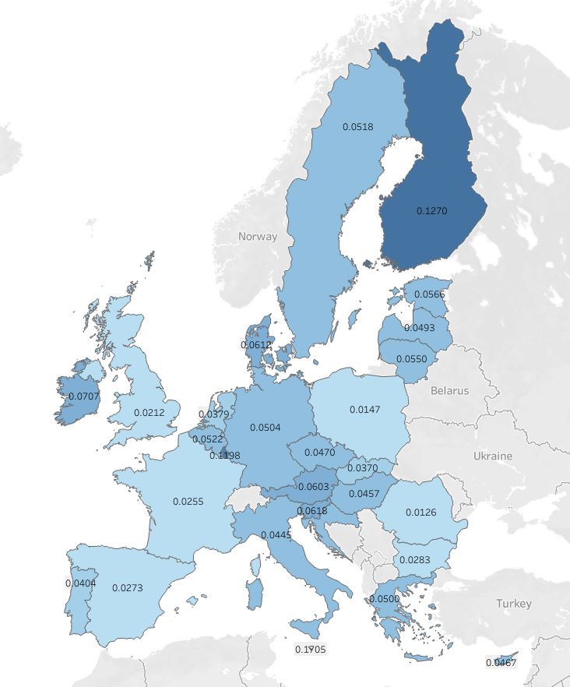
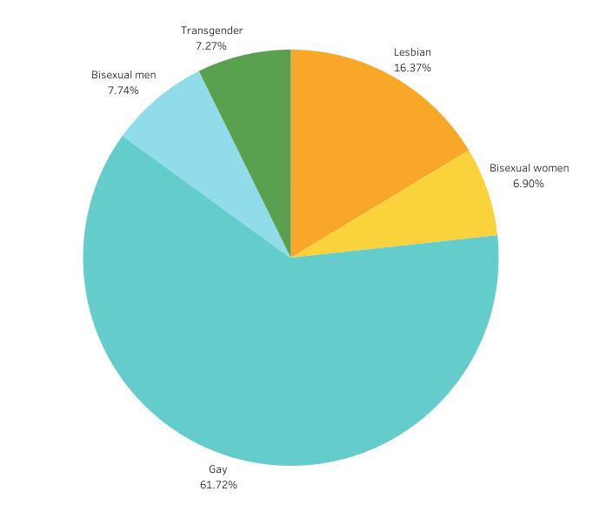
The respondents (per country and subset)
Notes:
Findings:
Malta, Finland and Luxembourg are highgly respresented with more than 0.1 % of the population participating in the survey.
In 8 countries less than 0.04% of the population participated.
There is no correlation between the situation of LGBT people in a country and low participation.
Yes, I made a pie-chart! Because expectation was 50/50 balance between men and women.
But this highlights the inbalance in the survey sample, where men (gay men specifically) are overly represented.
Unfortuantely we don’t have any other data, so we have to use what is available.

Slide 4
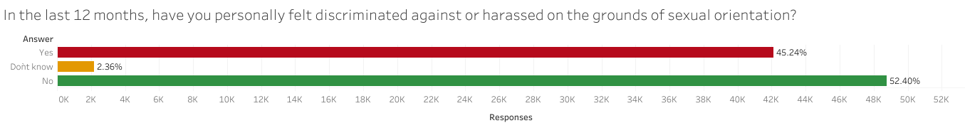
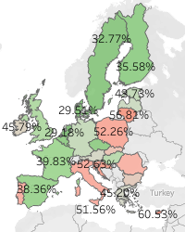
Is discrimination common?
Nearly half of the respondents have felt discriminated against on the grounds of their sexual orientation.
Looking at the differences per country, we can see some areas that are more problematic.
Notes:
Discrimination can range from being refused service (cabs in Amsterdam) to being passed on for a promotion at work, etc. This happened to 45% of the respondents in the last year (prior to the survey).

Slide 5
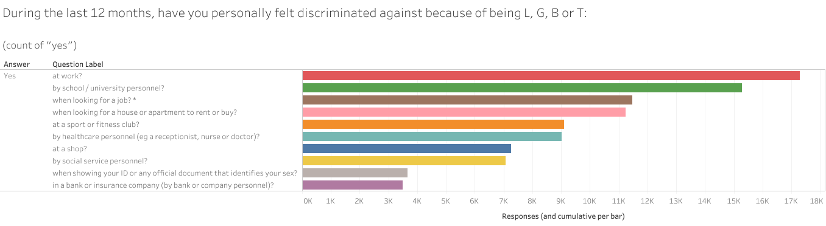
Where have respondents felt discriminated against?
We can see that work and school are two situations where discrimination is at its highest.
Notes:
We can also see that people can be discriminated against in more than one are of their life. This got me curious, so I checked again the cumulative discrimination per country…

